Slide 1

Group 2 Software Engineering project
E-Commerce Website:
Hug With Mug Coffee company
A
Notes:
Visit: http://ec2-54-172-16-142.compute-1.amazonaws.com/ to view our website
Visit our github repo: https://github.com/kassiejgarcia/Software-Engineering-Project

Slide 2




Background
Our e-commerce website is for a company named Hug With Mug.
At Hug With Mug, we sell products such as coffee, teas, t-shirts, tote bags, and mugs.
A

Slide 3
How it was made:
We used LEMP (L-Linux E-Nginx M-MySQL P-PHP) as our stack to develop our web application.
We used an Amazon EC2 Instance to host our application on the Amazon Web Services Infrastructure.
We developed with PHP, SQL, HTML, CSS and JavaScript Languages.
We used GitHub as our version control software to collaborate as a group.
A

Slide 4
Workflow
Developed in 2 Week Sprints
Meetings once a week
Sprints were planned based on what was uncompleted in our product backlog
Everyone worked from their own local environment, they pushed / pulled the project files and the database from our GitHub repository, then the project was publicly hosted through the Amazon Web Service.
K

Slide 5

UI / UX Design

Slide 6
UI / UX Design
We used bootstrap and CSS styles in general to design the front-end our website.
This means that many of the style classes we used are existing classes offered in bootstrap.
Many of our website elements were modified to be scalable items, such as: the slideshow images, visibility of far right nav bar items, and our product display blocks
Having items which can scale to any size allows for our website to be responsive, meaning it can be used by a variety of screen sizes from minimum to maximum display size to ensure usability and satisfaction.
N
Notes:
U

Slide 7

Functionality: User Experience

Slide 8
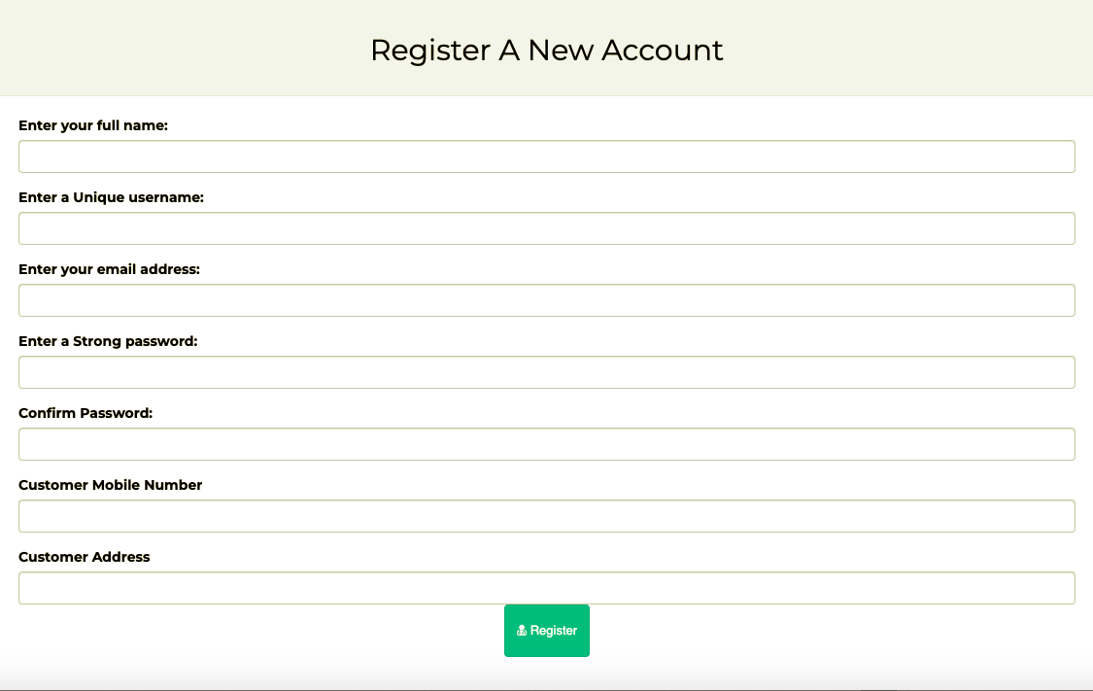
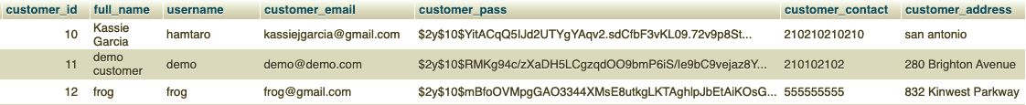
Signing Up For an Account
If a user would like to create a new account, they can do so by clicking the register page. Our website will take a user’s full name, username, email, password, phone number, and home address.
In our code, we cross check with our database and ensure there is not a user that already exists for the given username or email.
If all is good to go, we will update our database with the entered information, encrypt the password for safety concerns, and inform the user that they have been registered successfully.
If there was an error, the user will be redirected to try registering again.

Slide 9
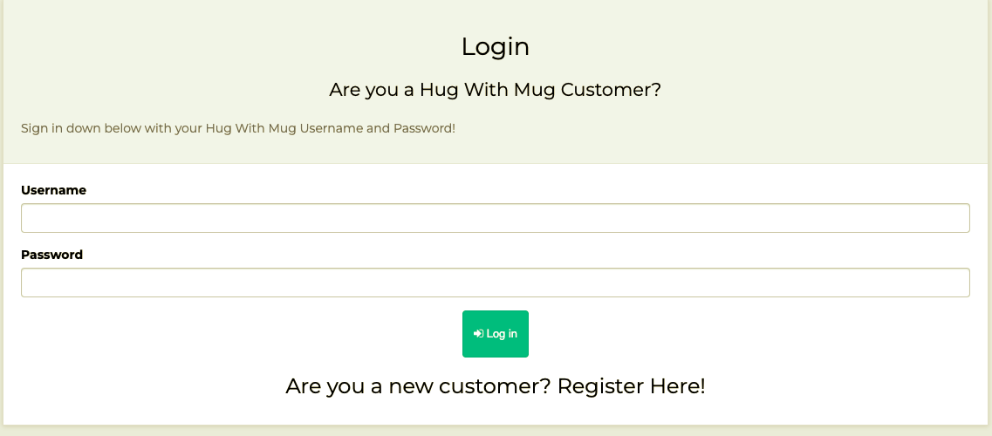
Log Into An Account
A user can sign in by visiting the sign in page.
In our sign in page, we take in a username and password. Then we cross check with our database to ensure a given user exists for that username, and that the password matches the encrypted one in the database.
If there was an error, the user will be redirected to try logging in again.
If all is good to go, a session is created for that user, and they will be redirected to their account page.
Once signed in, the user can now access certain features (i.e., checkout, wishlist, account page, etc.)

Slide 10
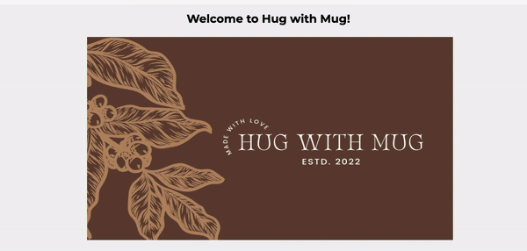
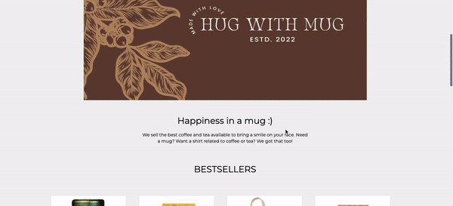
Home Page
Our homepage displays a slideshow consisting of three images showcasing the products that we sell. Below this, we show our “bestsellers”- which consists of 8 products shown in display blocks. These blocks include the first product image, an (optional) sale banner, a view details button, and an add to cart button which links the user to the product display page.

Slide 11
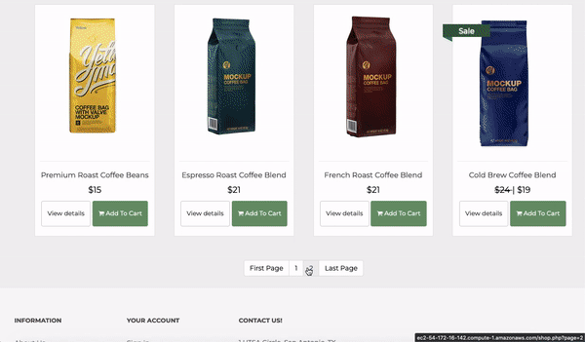
Shop Pages (shop all /By category)
The shop all page displays all the products we have stored in our database. These products are all displayed in blocks, as discussed in the last slide. The user can also switch back and forth between pages to view these products.
In the web application header, the user can also select either the coffee page, tea page, or merch page. They are all simply the shop page, except the product blocks are filtered by their respective categories.

Slide 12
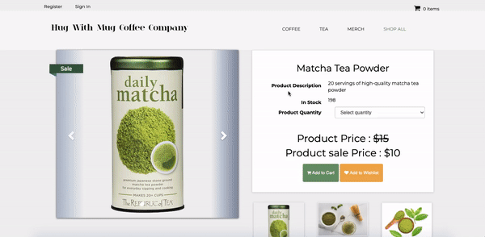
Product Display Page
Our product display page displays all the information about a single product. Depending on the product that was clicked on, we will display the corresponding product title, description, quantity in stock, quantity selection, the product price, the sale price (if on sale), the add to cart button, and the add to wish list button.
We also display the 3 product images for the corresponding product. These 3 images rotate amongst a carousel that the user can traverse through.

Slide 13
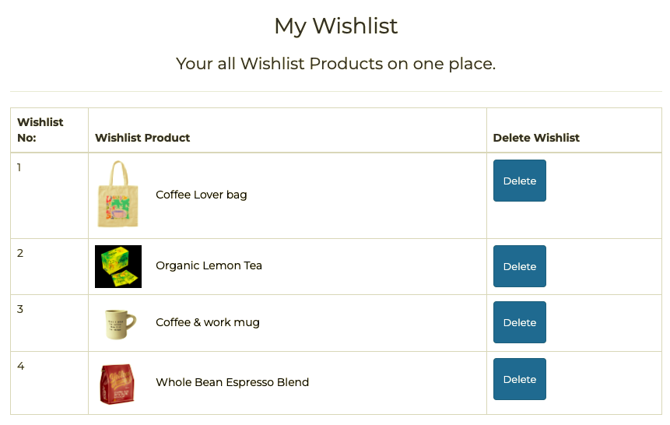
Add To Wish List
Anytime a user visits a product’s display page, they can click on the “add to wish list” button.
If the user is signed in, they can add any product to their wish list.
Then, the user may see the products in their wish list by visiting the “my wish list” page. From there, they can see an image of the product, the product title, and they even have the option to delete the product from the list.

Slide 14
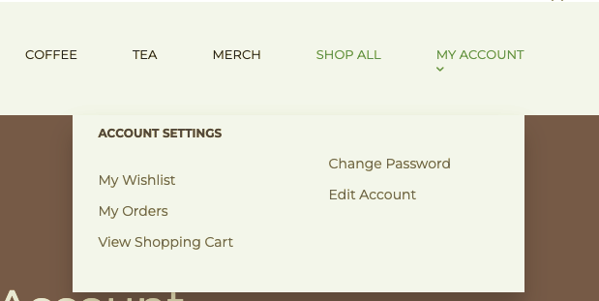
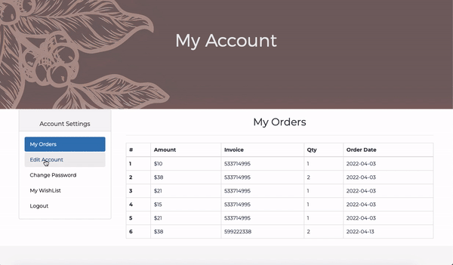
ACCOUNT Settings & Features
Once a user is logged in, they will be able to access different account features through the “my account” drop down menu.
My Wishlist Page
As seen in the previous slide, the user can view the saved items in their wish list.
My Orders Page
The user can view a list of all their placed orders. This list displays a list of product purchases, their corresponding order/invoice number, the quantity purchased, and the order date.
Change Password Page
A page where the user can change their password.
Edit Account Page
A page where the user can edit their account information.

Slide 15
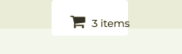
Add to cart (Part 1)
Cart Icon which displays throughout website
Users have the option to add any product to their shopping cart. A user’s cart will be saved if they are logged in, logged out, or come back a few hours later- as a session for the cart is created and tracked based on their IP address. To visit their shopping cart, a user can click on the cart icon on the top right of the homepage. In this cart page, a table will display the products image, title, quantity selected, price, total, and an option to select the product for deletion.
There is also a discount code option which will apply to certain products that are enabled to have a code applied to them. A discount code will take off a certain amount for a single product.
For example, “HUGWMUG5OFF” will take 5 dollars off the “coffee lover bag”.
There is also an order summary, which displays the true calculated total (subtotal + tax + shipping (- discount)) that the user will “pay” for at checkout.

Slide 16
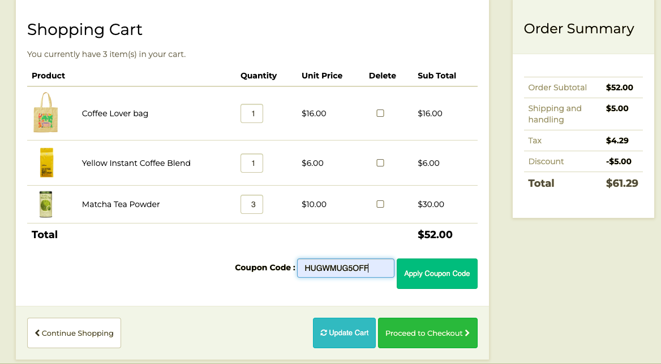
Add to cart (Part 2)
Cart table
Order Summary
Discount Code

Slide 17
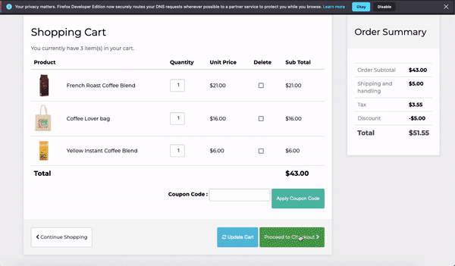
Placing The Order
Once a user is signed in and have items in their cart, they will be able to “proceed to checkout”. From there, they can click to place their order. Once the order is placed, the database is updated with the customer’s order, and the user will be notified that their order was successfully placed. They can then visit the details of their order in their “my account” page-> my orders.

Slide 18
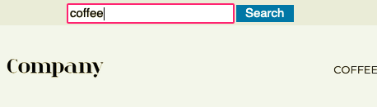
Search
The search engine works as a function for the user to search for a specific product or anything related to the website.
The user can search for coffee, tea, and merchandise products.
The user can type into the search box located on the home page and click the “search” button. After the “search” button is clicked it will display the search results to the user if any keywords are matched from the database. If no matches are found, then the search feature will ask the user to search again. The results that will be displayed will depend on the matching keywords.
For example: if the user searches for coffee, then the search feature will display the results found for “coffee”, the keyword “coffee”, and a functioning link that the user can click on to be directed to the web page related to the search.
H

Slide 19
Functionality: Admin Panel

Slide 20
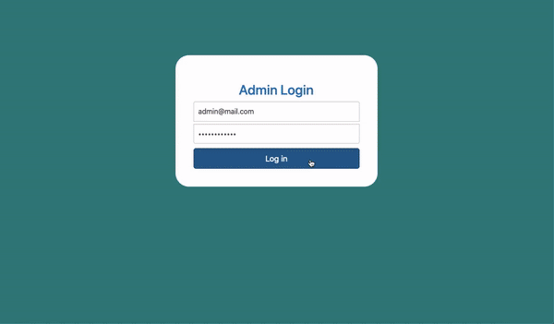
ADMIN LOGIN
If an admin user wants to visit the admin backend panel, they can do so by visiting http://ec2-54-172-16-142.compute-1.amazonaws.com/admin_area .
From there, they will be prompted to log in with their admin credentials. The credentials entered are cross checked with the admin database table. If the credentials entered match with what is in the database, then the admin user can successfully access the admin panel. If not, the admin will be prompted to try logging in again.
Notes:
You can log in and view this admin panel for yourself. Just visit http://ec2-54-172-16-142.compute-1.amazonaws.com/admin_area and login with username: admin@mail.com | password: Password@123

Slide 21
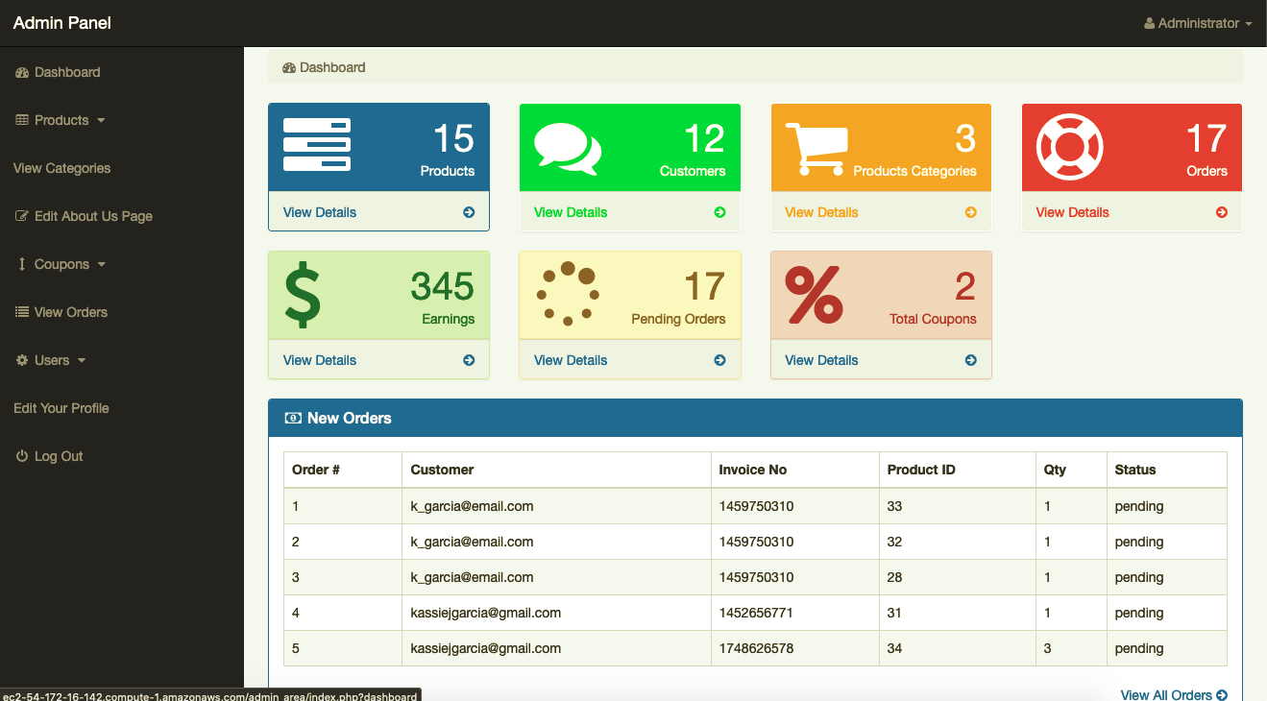
ADMIN PANEL
Sidebar
Dashboard
ADMIN DASHBOARD
This dashboard conveniently displays important information blocks for the admin. It displays the # of products currently for sale, the # of customers, the # of product categories, the # of orders currently placed, the total amount of money earned, and the total number of coupon codes enabled.
Within each of these blocks, the admin can click to view more details, which will take them to their perspective pages.
At the bottom of the dashboard, the admin can readily see the most recent orders placed by customers.
ADMIN SIDEBAR
This sidebar is where the admin user can access all the admin features- such as viewing/inserting/editing products for sale, viewing orders, and more!

Slide 22
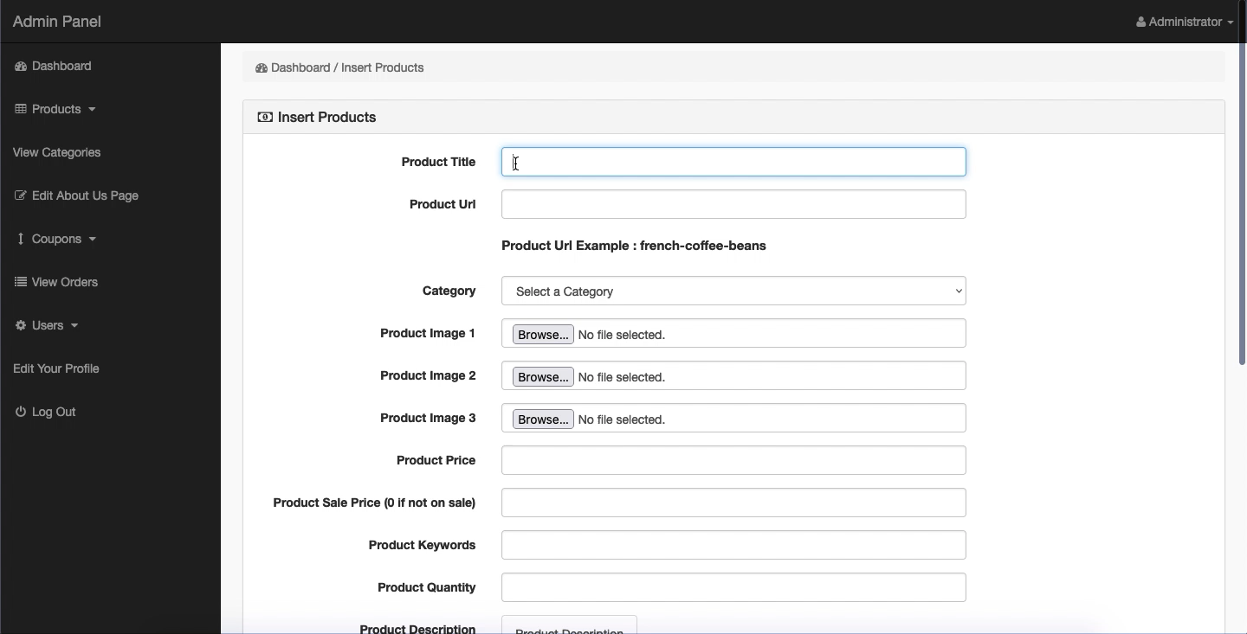
Insert Products
Inserting an “on sale” product
From the admin panel sidebar, the user can access the products section. In this section, the admin user has the option to either visit the insert products page or the view products page.
Insert Products Page
To insert a regular product, the admin user will simply enter in all the product information necessary for its display (title, url, category, images, price, keywords, quantity, description, label)
To insert an ‘on sale’ product, the admin user will simply enter in all the information necessary, including the product’s sale price and product’s label (”Sale”).

Slide 23
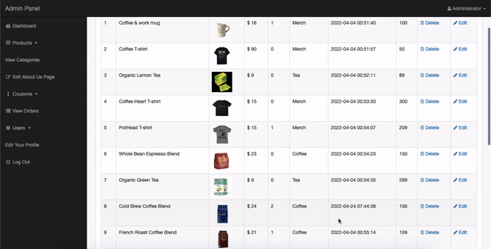
View & Modify Products
Viewing and editing an existing product
View Products Page
From this page, the admin user can view all the products that are currently for sale on the website. The list displays all the product information and links to either delete the item or to modify the item.
Modify Product Page
If the user selects to “edit” a product, they will go to the modify product page. From this page, the form will pre-fill with all the product information currently stored in the DB. Once changes are made, the admin user can click to update the product and can immediately see the changes reflected in the view products page & website.

Slide 24
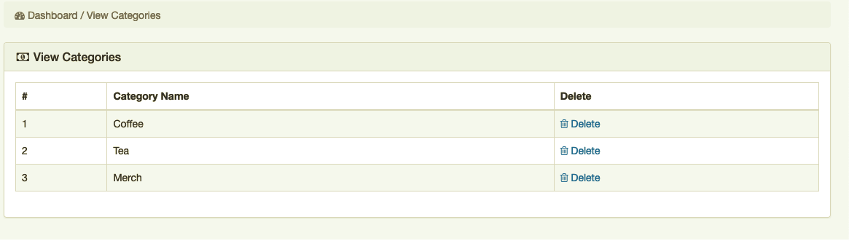
View Categories
Admin user can go to the view categories page which simply displays the categories in use, and they have the option to delete these categories as well.

Slide 25
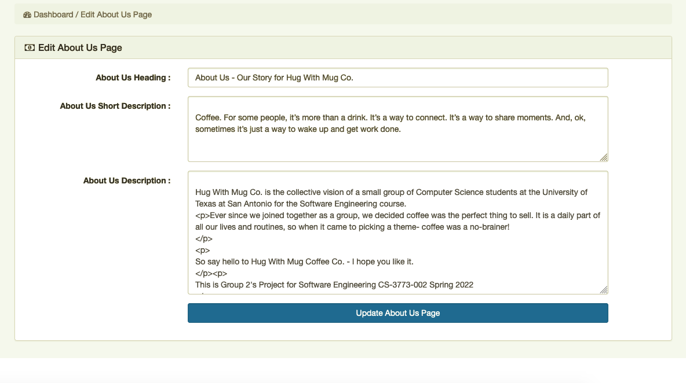
Edit About US Page
The admin user can visit the edit about us page, which will contain a form which will prefill with the “about us” text stored in the DB. From here, the user can make changes to this description and update the page.

Slide 26
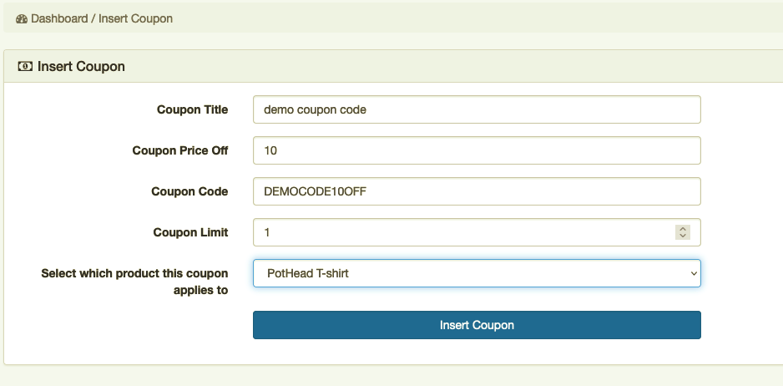
INSERT COUPON CODES
From the admin panel sidebar, the user can access the coupons section. In this section, the admin user has the option to either visit the insert coupon page or the view coupons page.
Insert Coupon / Discount Code Page
In this page, the admin user can create a new coupon code for the website. This page will take in the coupon title, the amount that should be taken off, the code, the usage limit to the code, and a selection box to select which product this code should apply to. If there are no errors, the coupon will be inserted into the DB.

Slide 27
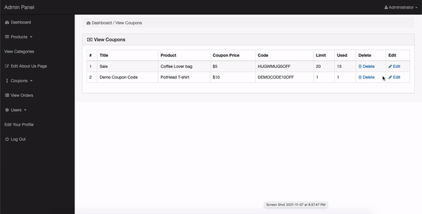
View & Modify Coupon CODES
From the view coupons page, the admin user can view all the coupon codes available for customers to use. The list displays the coupon title, product it applies to, price off, code, limit, how many times it has been used, an option to delete the coupon code, and an option to edit the coupon code.
Through the view coupon page, the admin user can select to “edit” a coupon. This edit coupon page will pre-fill with all the coupon information currently stored about the coupon selected. Once changes are made, the admin user can click to update the coupon and can immediately see changes reflected in the coupon list..

Slide 28
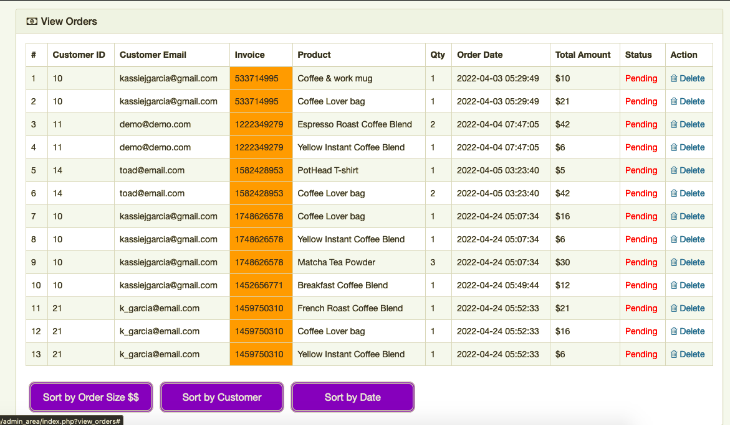
View & Sort ORDERs
From the admin panel sidebar, the user can access the view orders page. In this page, the admin user can see a list of all the currently placed orders from all customers. This list displays the order’s customer, the invoice / order number, the product ordered, the quantity of the product ordered, the date the order was placed, the total amount spent on the product ordered, the order status, and an option to delete the order from the database.
Order Sorting Functionality: In this order page, the admin user can sort the orders either by the order size (dollar amount), the order date, or by the customer in alphabetical order. All the user has to do is click on the sort buttons at the bottom of the list and they can sort how they please.

Slide 29
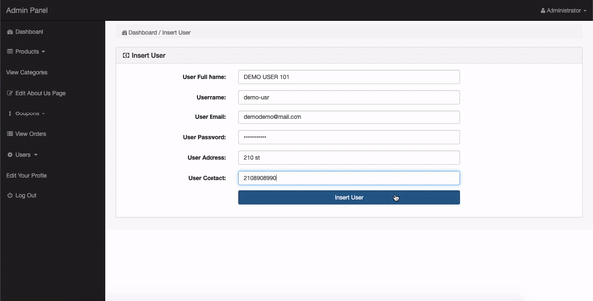
INSERT A USER
From the admin panel sidebar, the user can access the users section. In this section, the admin user has the option to either visit the insert users page or the view users page.
Insert Users Page: In this page, the admin user can insert a new user for the website. The admin user must enter a name, username, email, password, address, and contact info correctly. If the information entered is correct, the database will be updated with a brand-new user inserted and the admin user will be notified of its success.

Slide 30
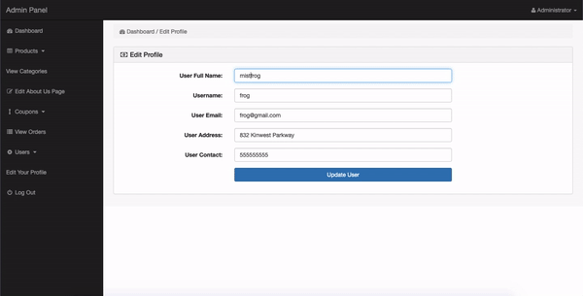
VIEW & MODIFY EXISTING USERS
In the view users page, the admin user can view a list of customer users. This list displays a name, username, email, address, and phone number. There are also 2 options to either delete the user from the database or to edit the user via edit user page.
Edit a User Page: When the admin selects to “edit” a user, they will go to the edit user page. From this page, the form will pre-fill with all the user information currently stored in the database. Once a change is made, the admin user can click to update the user and will be notified if that update was successful.

Slide 31
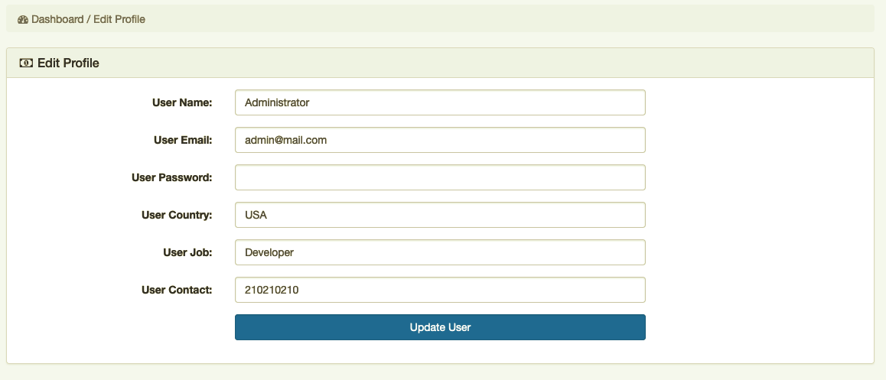
EDIT ADMIN PROFILE
From the admin panel sidebar, the user can access the edit your profile page. In this page, the admin user can edit their own profile and update their changes to the database. The admin user will be notified if their changes were successful.

Slide 32

THE END
Thank you for watching our presentation!

